Slide 1
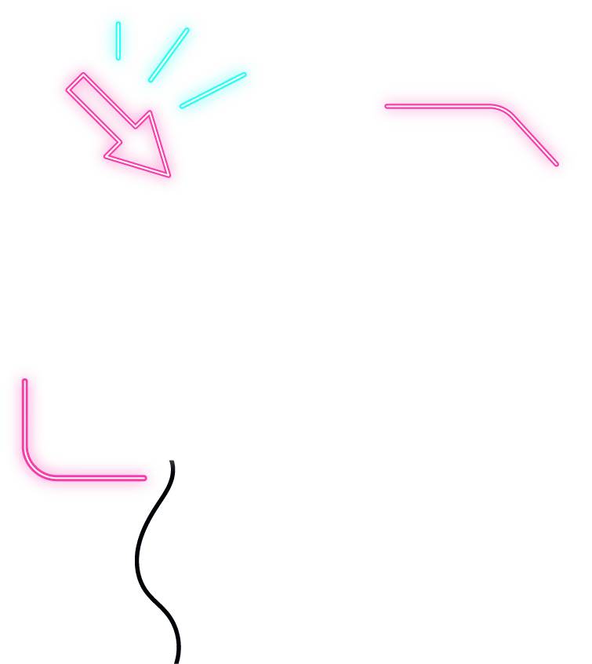






IOT WORKLOAD CHARACTERIZATION IN NEXT GENERATION CLOUD SYSTEMS UPDATE
Supervised by: Dr. Karan Mitra, Dr. Saguna Saguna,
Dr. Christer Åhlund
Presented by: Fatema Mirza

Slide 2






Introduction
TABLE OF CONTENTS
Distribution Per day half hour only
Findings & Next steps
Distribution Per day basis only
Distribution Per day hour only
fatmir-0@student.ltu.se

Slide 3
01
Queueing Model
fatmir-0@student.ltu.se

Slide 4









Housing complex
fatmir-0@student.ltu.se 26/01/2022 | 03

Slide 5
Sensors in the Apartment
Apt#1 N/A
Apt#5 Total: 9
Coffee machine, kitchen motion sensor
Apt#2
Total: 11
Kitchen motion sensor, micro
Apt#6
Total: 10
Water boiler, kitchen motion sensor
Apt#3
Total: 8
Coffee machine, kitchen motion sensor
Apt#7
Total: 11
Bathroom motion sensor, water meter
Apt#4
Total: 9
Coffee machine, micro, kitchen motion sensor
Apt#8
N/A
fatmir-0@student.ltu.se 26/01/2022 | 03

Slide 6
02
Distribution Per day basis only
fatmir-0@student.ltu.se

Slide 7

01
02
Distribution Categories
03
Per day basis only
Per hour basis only
Per half an hour basis only
fatmir-0@student.ltu.se 26/01/2022 | 10

Slide 8
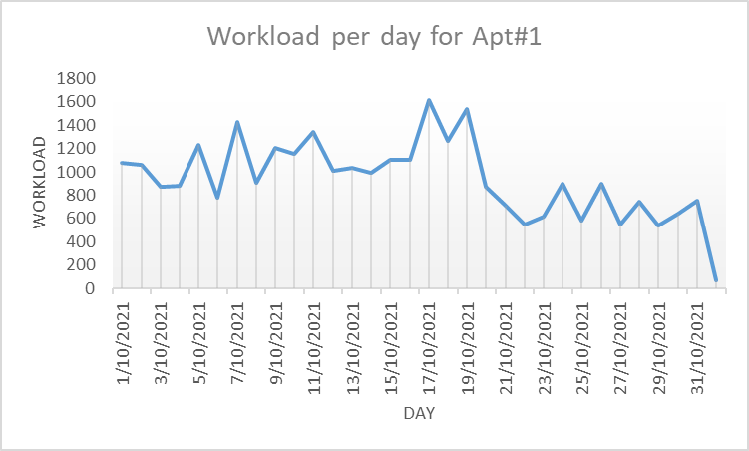
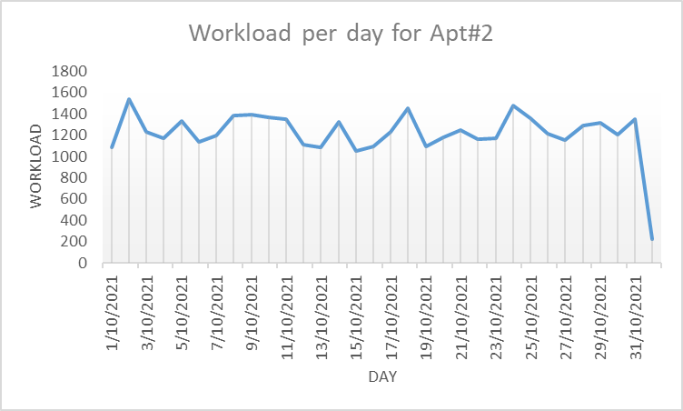
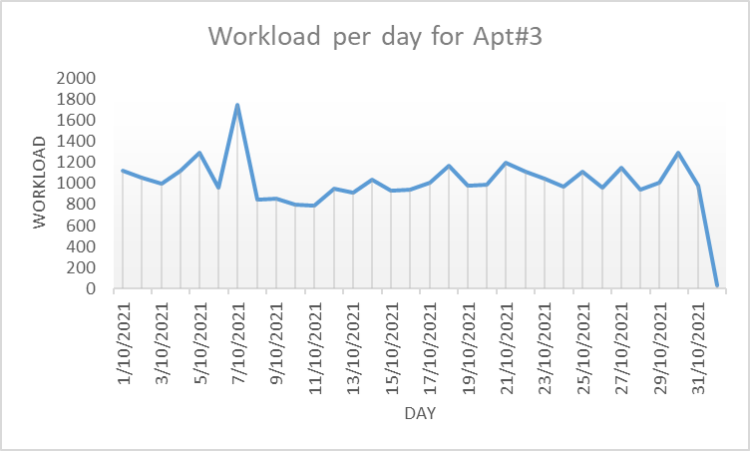
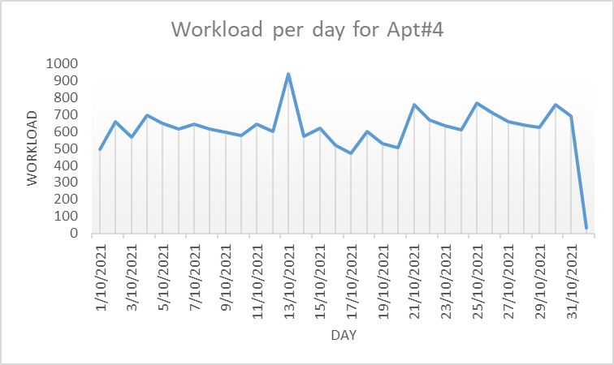
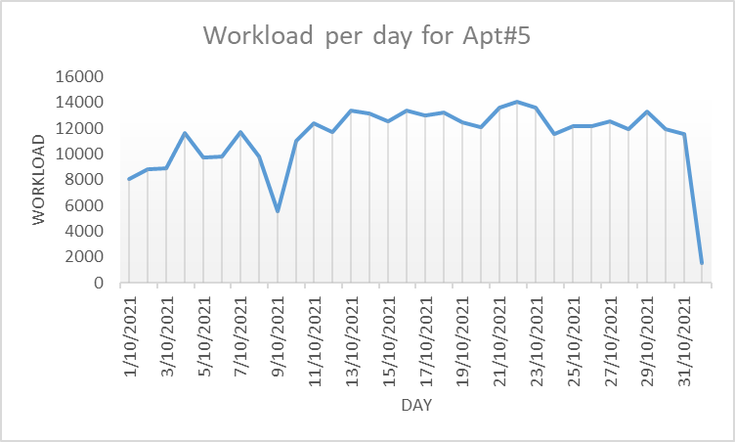
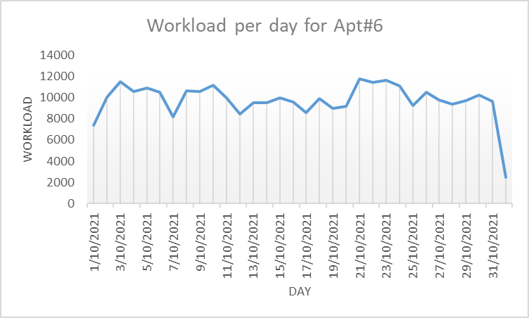
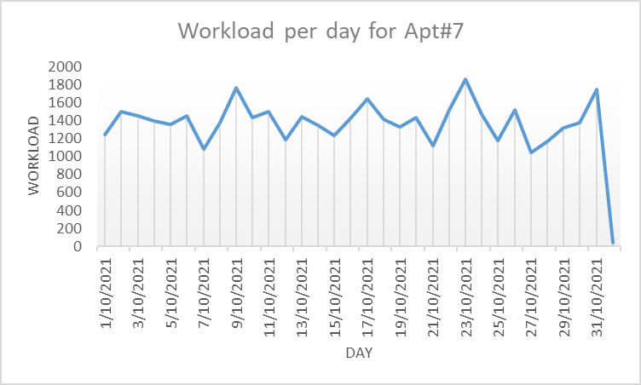
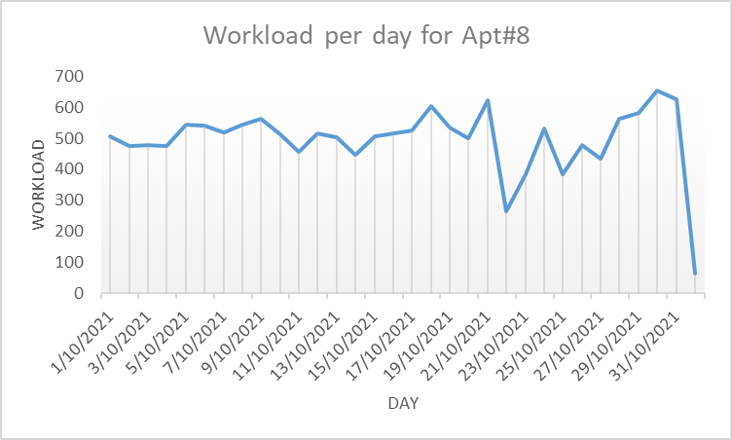
Workload per day per apartments

Slide 9
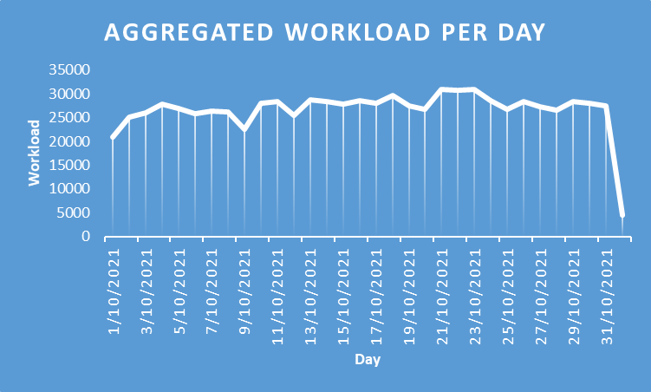
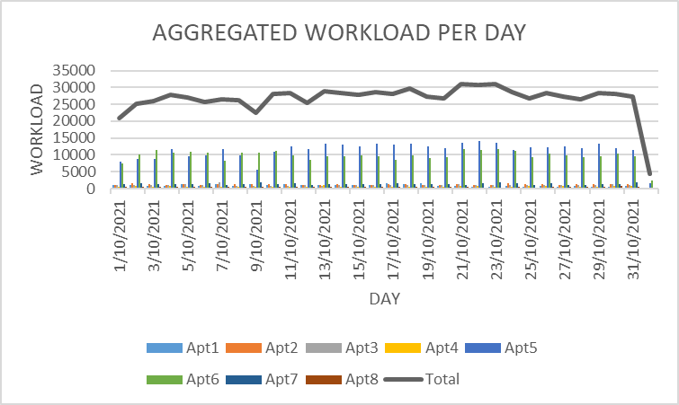
Aggregated Workload per day
fatmir-0@student.ltu.se 26/01/2022 | 04

Slide 10
03
Distribution Per hour basis only
fatmir-0@student.ltu.se

Slide 11
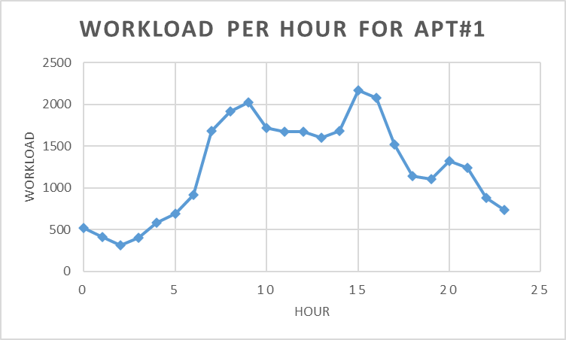
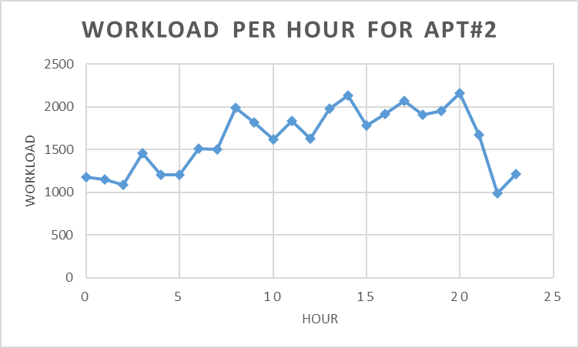
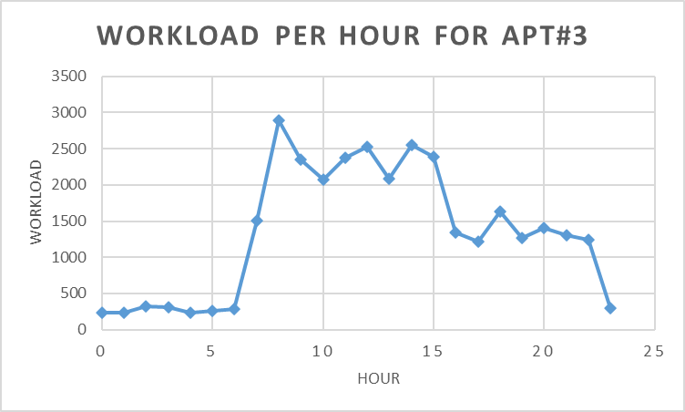
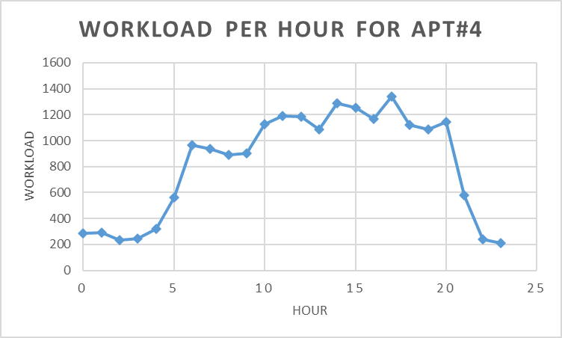
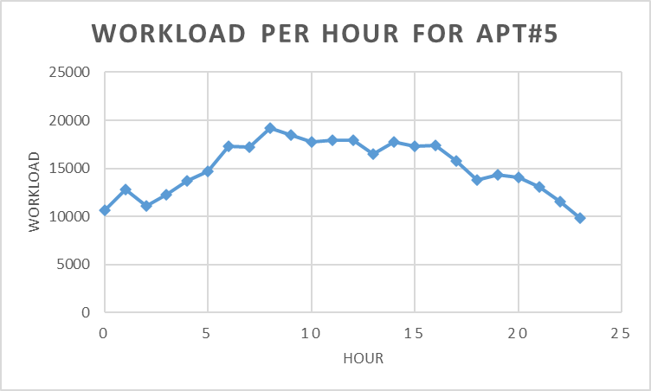
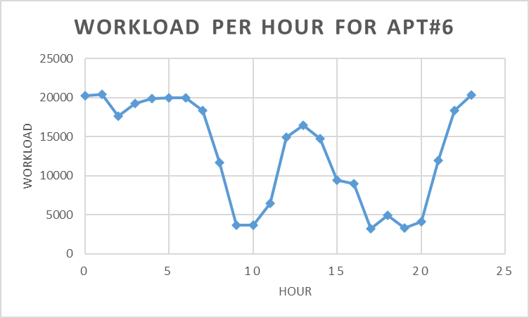
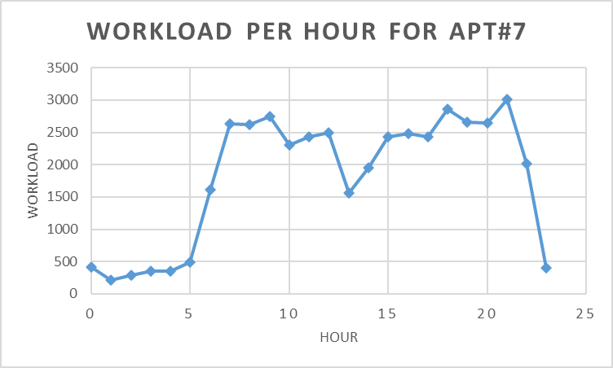
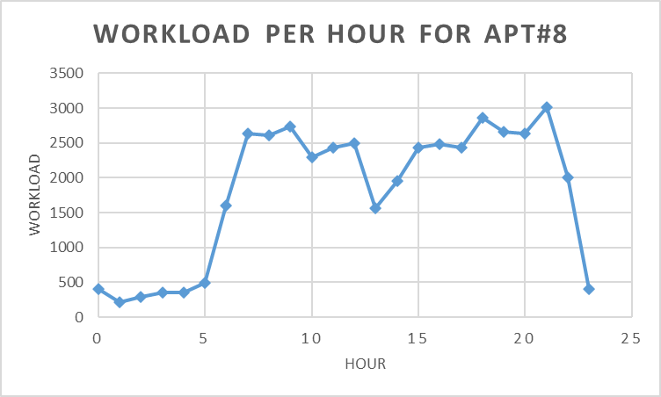
Workload per hour per apartments

Slide 12
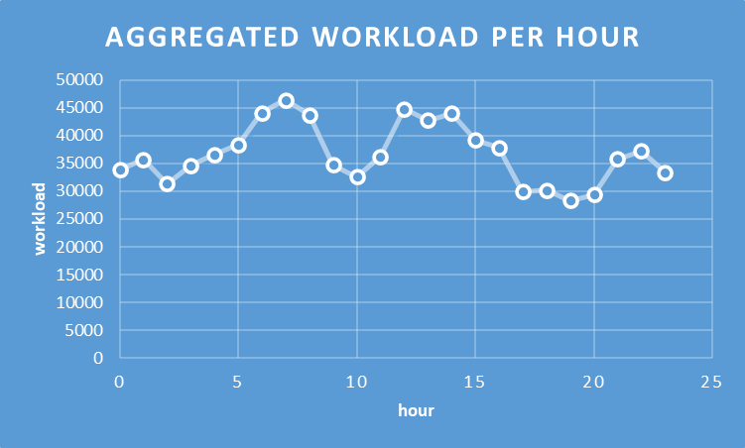
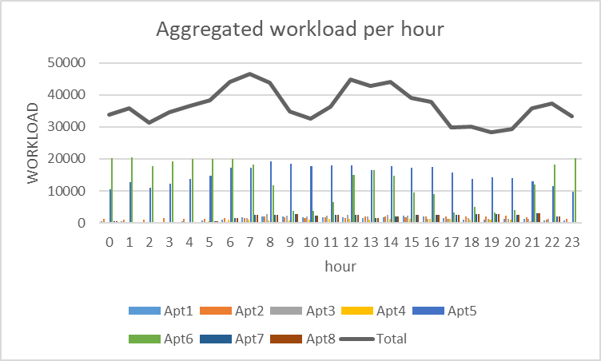
Aggregated Workload per hour
fatmir-0@student.ltu.se 26/01/2022 | 04

Slide 13
04
Distribution Per half hour basis only
fatmir-0@student.ltu.se

Slide 14
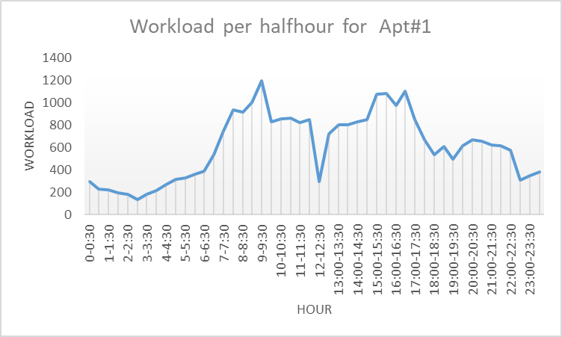
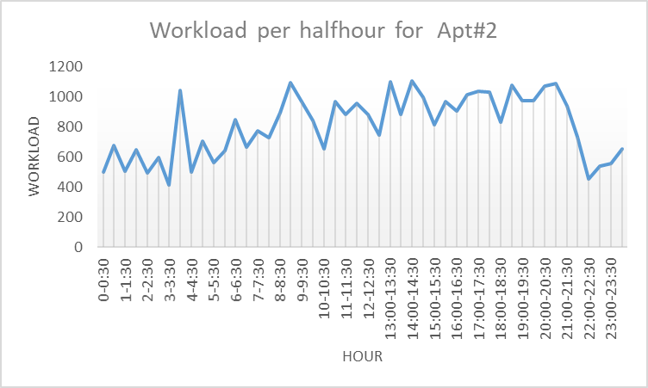
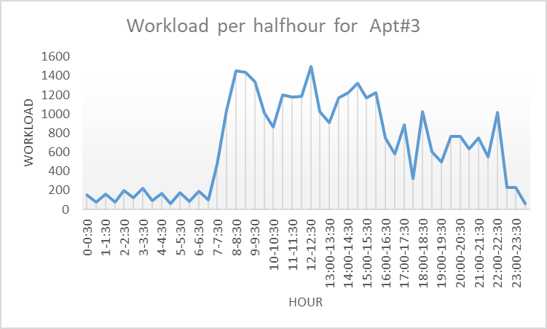
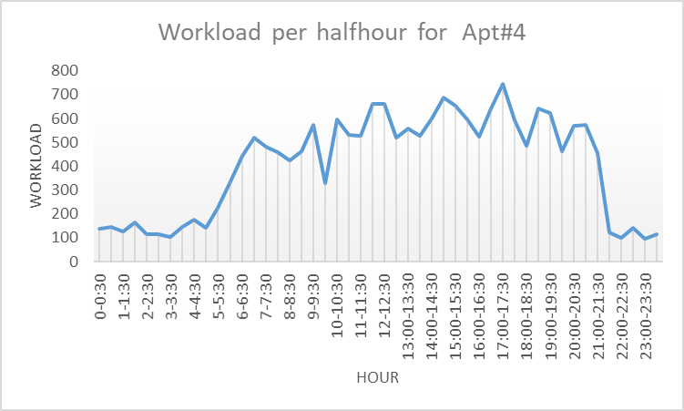
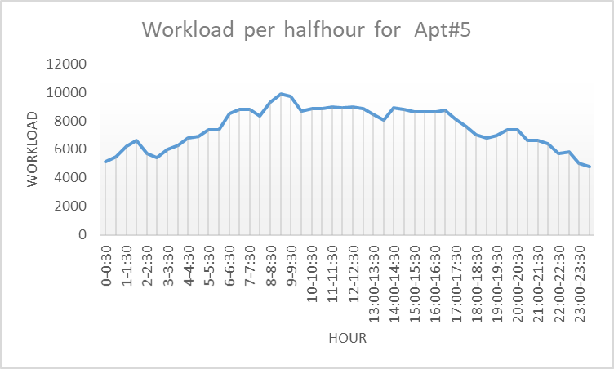
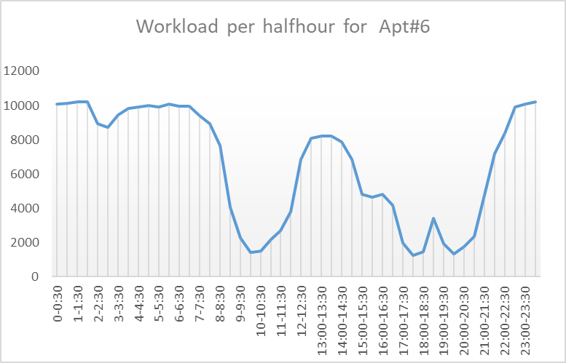
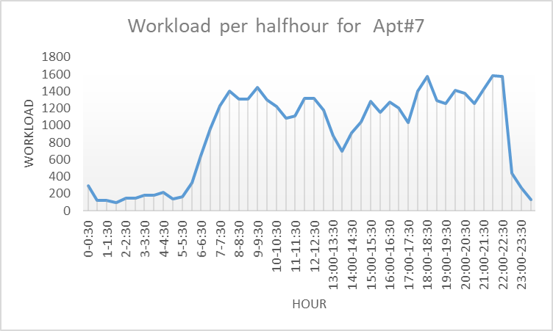
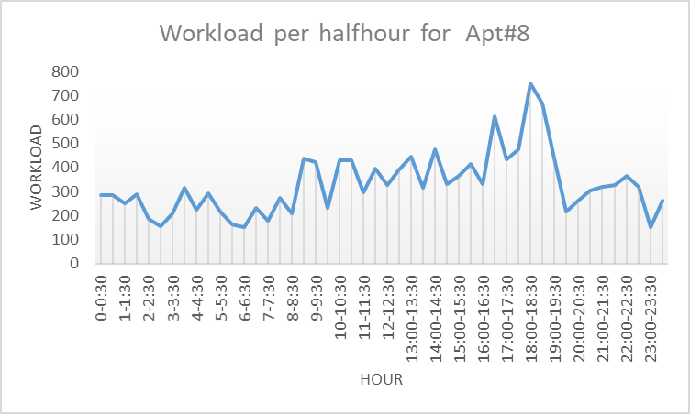
Workload per half hour per apartments

Slide 15
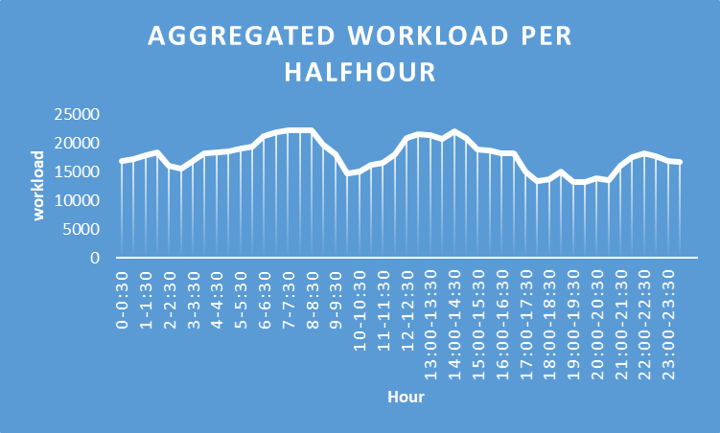
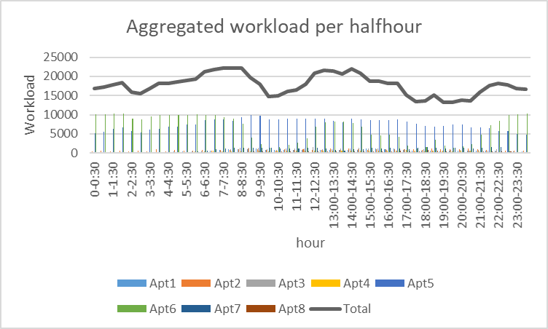
Aggregated Workload per half-hour
fatmir-0@student.ltu.se 26/01/2022 | 04

Slide 16
05
Findings
fatmir-0@student.ltu.se

Slide 17


Findings & Next steps
There is some overlap in the characteristics of the apartments (as explained during demo)
Do minute wise distribution to exploit this more
Do minute wise daily to find if weekly trends exist
Explore more about PDF and CDF (already explored that PDF is the derivative of CDF) with the dataset
Read more of Performance Modeling and
Analysis of Communication Networks^{[9]}
fatmir-0@student.ltu.se 26/01/2022 | 13to find weekly trends (if it exists

Slide 18

Thank you! Tack så mycket
Any Questions?
fatmir-0@student.ltu.se

Slide 19
02
Queueing Model for IoT-Cloud for Markov Model
fatmir-0@student.ltu.se

Slide 20
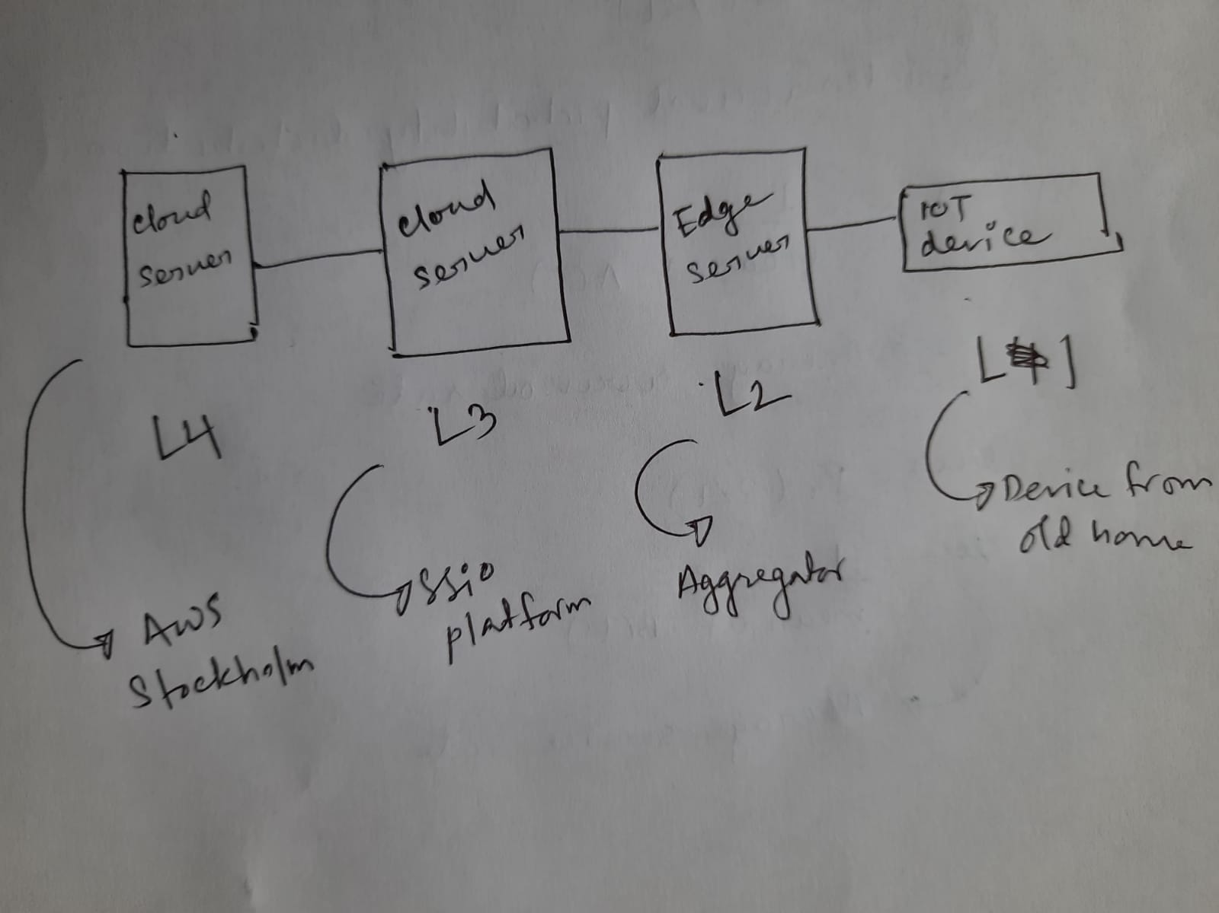
Hypothesized Model for IoT-Cloud
fatmir-0@student.ltu.se 26/01/2022 | 04

Slide 21
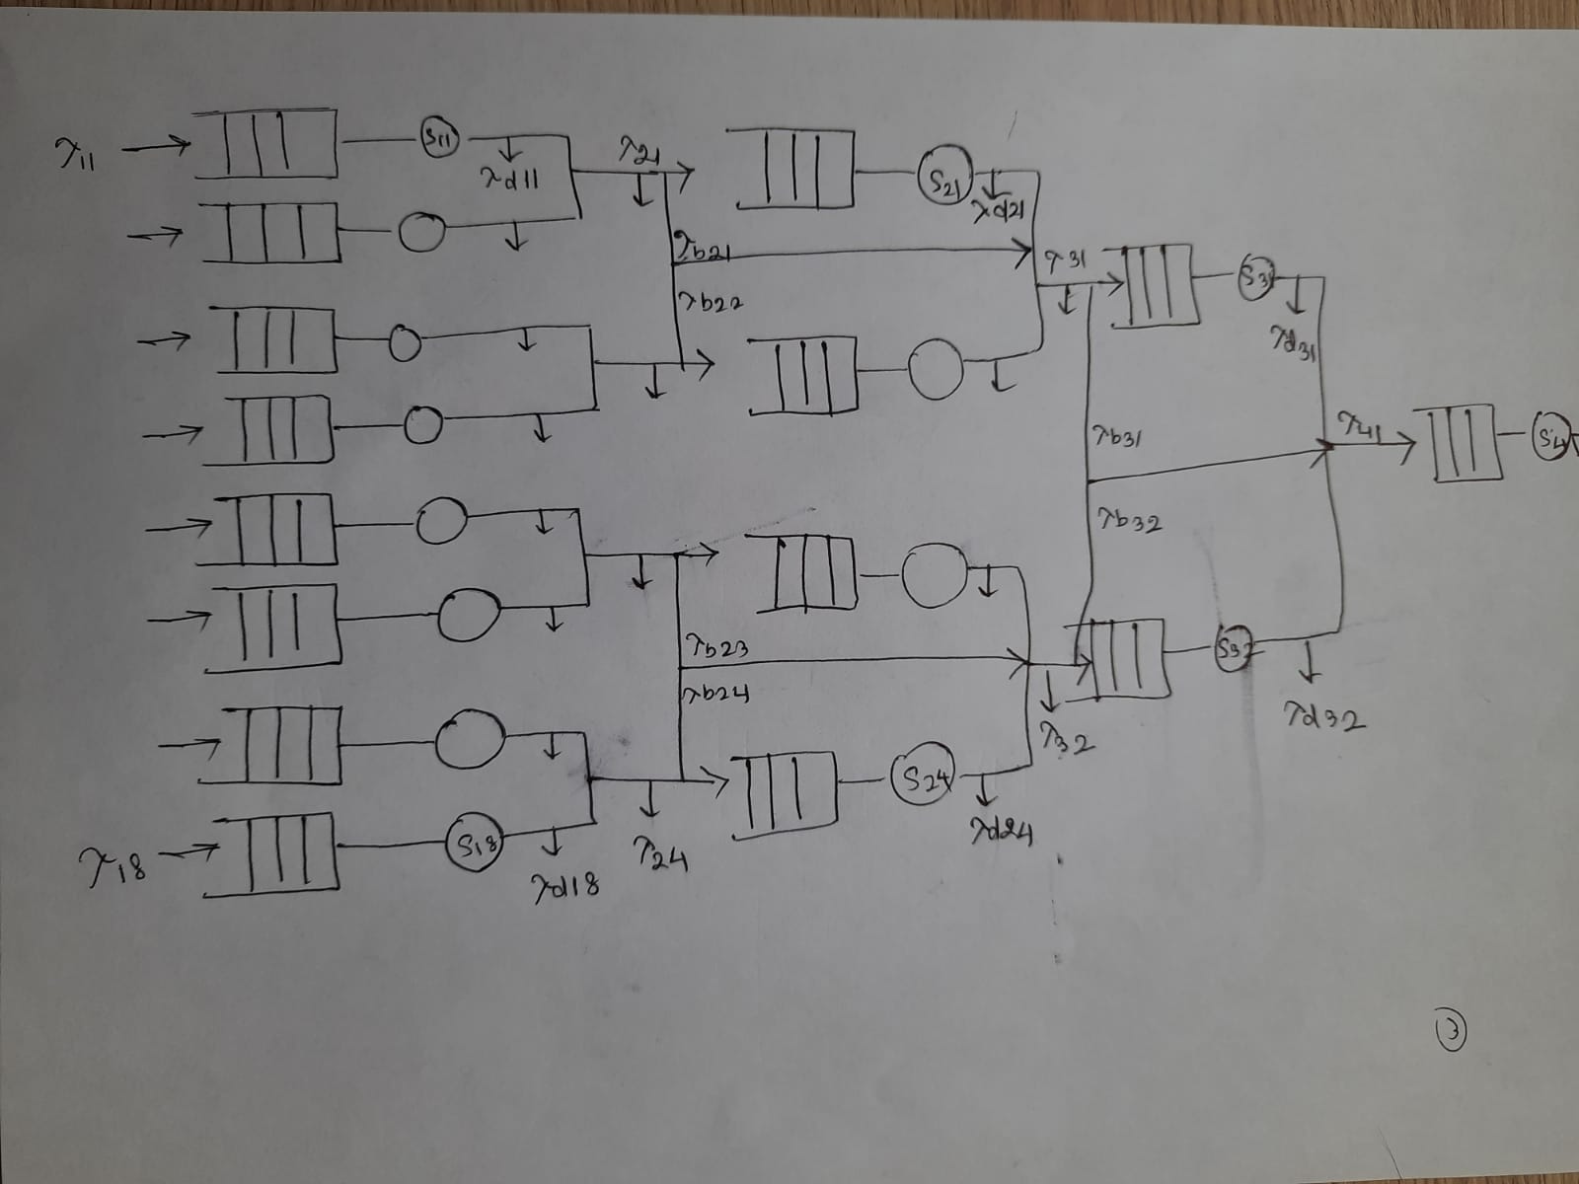
Queueing model for IoT-Cloud
fatmir-0@student.ltu.se 26/01/2022 | 05

Slide 22

Burke Theorem^{[3]}
Burke’s theorem is a well-known fundamental result in queueing theory, stating that a stationary M/M/1 queue has a departure process that is identical in law to the arrival process and, moreover, for each time t, the following three random objects are independent: the queue length at time t, the arrival process after t and the departure process before t.
fatmir-0@student.ltu.se 26/01/2022 | 06

Slide 23
Jacksonian Network^{[4]}
In queueing theory, a discipline within the mathematical theory of probability, a Jackson network (sometimes Jacksonian network) is a class of queueing network where the equilibrium distribution is particularly simple to compute as the network has a product-form solution.
fatmir-0@student.ltu.se 26/01/2022 | 07

Slide 24
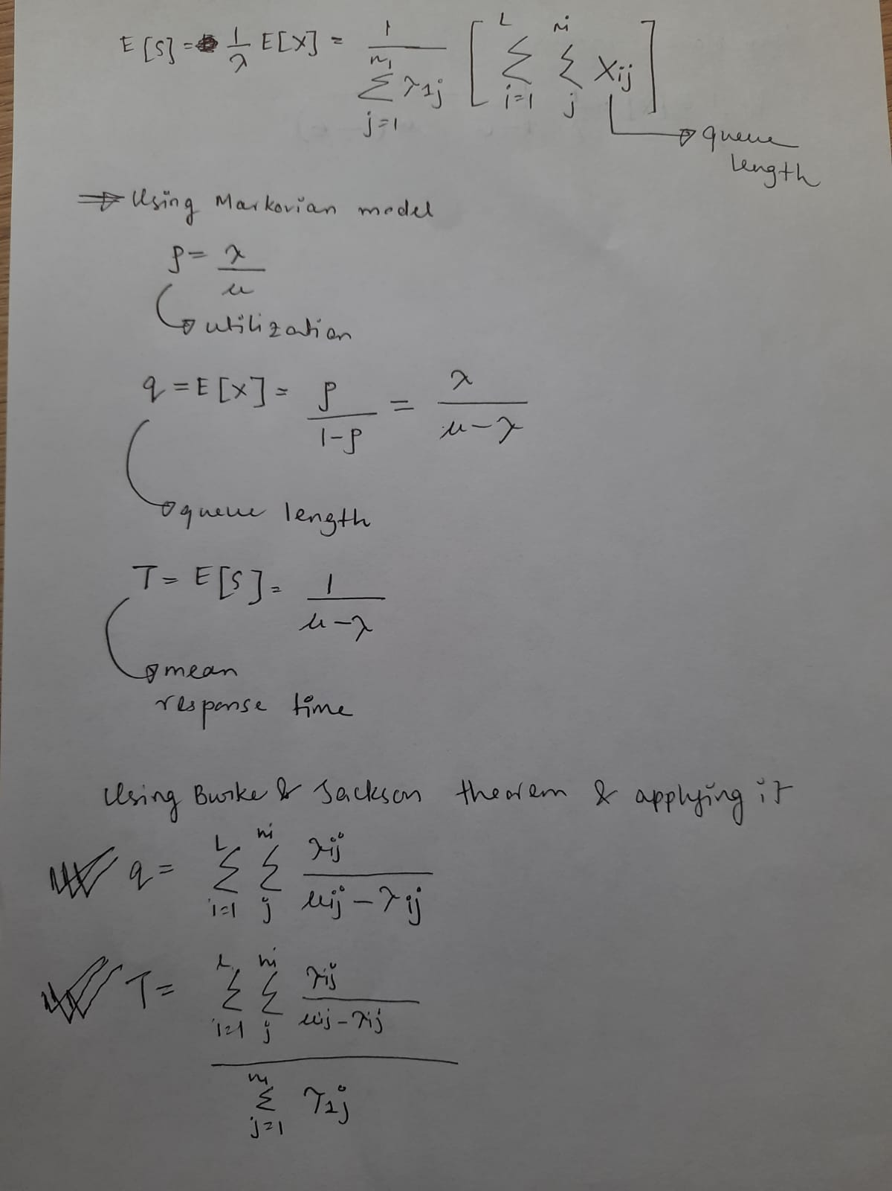
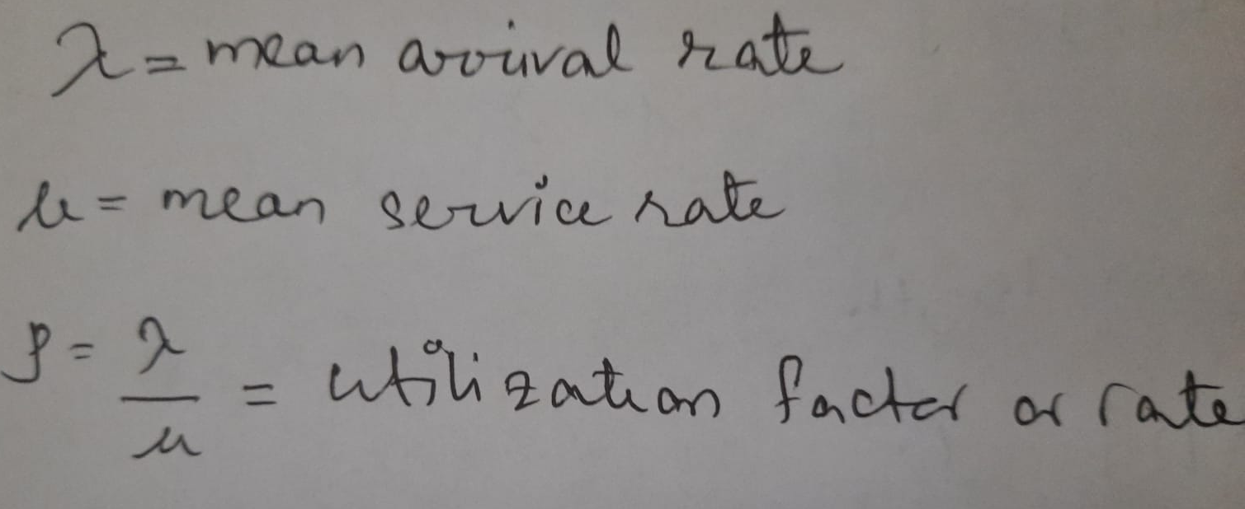
Average Response Time & queue time w.r.t queue models
fatmir-0@student.ltu.se 26/01/2022 | 08

Slide 25

Working on semi markovian model …
fatmir-0@student.ltu.se

Slide 26
What is semi markovian model?
Where IOT has no memory at all and all is sent to a hub.
fatmir-0@student.ltu.se 26/01/2022 | 09

Slide 27
03
Different types of Distribution
fatmir-0@student.ltu.se

Slide 28
Weibull
Gen. Pareto
Distribution Types^{[5]}
Poisson
Light and temperature
Motion
Hypothesized aggregated data of interval times
fatmir-0@student.ltu.se 26/01/2022 | 10

Slide 29
04
T-drive dataset^{[6,7,8]}
fatmir-0@student.ltu.se

Slide 30
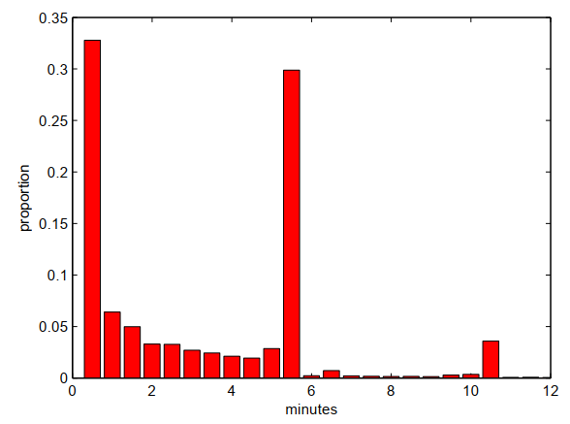
Histogram of time b/w two consecutive points
fatmir-0@student.ltu.se 26/01/2022 | 11

Slide 31
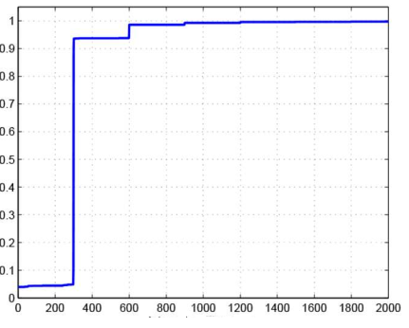
CDF for taxi 19
fatmir-0@student.ltu.se 26/01/2022 | 12
Notes:
The rapid increase in connected device (or IoT device) usage by commercial entities and consumers is changing the topography of the internet Connected devices have been designed to fulfill functional requirements (i.e. observe, control and maintain a piece of machinery remotely), but have often failed at incorporating proper green aspects in their design. The integration of the Internet of things and cloud computing has led to the emergence of new classes of applications ranging from smart healthcare, smart and precision agriculture, smart manufacturing to smart environmental monitoring. The rapid surge in the use of these applications is expected to generate massive amounts of data with different characteristics that are yet not studied.

Slide 32
05
Findings
fatmir-0@student.ltu.se

Slide 33
Findings
Find the equation for semi Markov model
Explore the dataset with E, GE, P, GP, LN, G, WB and then check with KS mean and variance and find the lowest with original one.
Explore more about PDF and CDF (already explored that PDF is the derivative of CDF)
Explore t drive dataset with E, GE, P, GP, LN, G, WB and then check with KS mean and variance and find the lowest with original one.
Do EDA on the real data
Read more of Performance Modeling and
Analysis of Communication Networks^{[9]}
Finish this by 10 Feb
fatmir-0@student.ltu.se 26/01/2022 | 13

Slide 34
Thank you! Tack så mycket
Any Questions?
fatmir-0@student.ltu.se

Slide 35
References
[1] https://www.youtube.com/watch?v=SqSUJ0UYWMQ
[2] https://techcrunch.com/2014/11/08/littles-law-is-big-for-startups/?guccounter=1&guce_referrer=aHR0cHM6Ly93d3cuZ29vZ2xlLmNvbS8&guce_referrer_sig=AQAAAFvY4BNr5Vvu2uDhXO4VTDuLiVSsISoGSjMxJMxW1Pt6ar11_kEY1wq5aw5HlXlySpE0jUAVwaZrqBu00JlSq7EUCeucjIMrTrHpRp59P000WKfozg64v5gANPPBZ1cB1W72iB8KG7aZ9xlUhU3E68QBMT2CsMngoCUV5UZ2HcNW
[3] Konstantopoulos, T. A review of Burke’s theorem for Brownian motion. Queueing Syst 83, 1–12 (2016). https://doi.org/10.1007/s11134-016-9478-x
[4] Chen H., Yao D.D. (2001) Jackson Networks. In: Fundamentals of Queueing Networks. Stochastic Modelling and Applied Probability, vol 46. Springer, New York, NY. https://doi.org/10.1007/978-1-4757-5301-1_2
[5] M. López-Benítez, C. Majumdar and S. N. Merchant, "Aggregated Traffic Models for Real-World Data in the Internet of Things," in IEEE Wireless Communications Letters, vol. 9, no. 7, pp. 1046-1050, July 2020, doi: 10.1109/LWC.2020.2980272.
[6] M. López-Benítez, C. Majumdar and S. N. Merchant, "Aggregated Traffic Models for Real-World Data in the Internet of Things," in IEEE Wireless Communications Letters, vol. 9, no. 7, pp. 1046-1050, July 2020, doi: 10.1109/LWC.2020.2980272.
[7] ing Yuan, Yu Zheng, Chengyang Zhang, Wenlei Xie, Xing Xie, Guangzhong Sun, and Yan Huang. Tdrive: driving directions based on taxi trajectories. In Proceedings of the 18th SIGSPATIAL International
Conference on Advances in Geographic Information Systems, GIS ’10, pages 99{108, New York, NY, USA,
2010. ACM.
[8] Huang, Jiwei & Li, Songyuan & Chen, Ying & Chen, Junliang. (2018). Performance modelling and analysis for IoT services. International Journal of Web and Grid Services. 14. 146. 10.1504/IJWGS.2018.090742.
[9] Tran-Gia, Phuoc & Hossfeld, Tobias (2021). Performance Modeling and Analysis of Communication Networks
- A Lecture Note. Würzburg University Press. https://doi.org/10.25972/WUP-978-3-95826-153-2
fatmir-0@student.ltu.se 17/12/2021 | 15

